Slide 1
Muscles
Topic 1.2 (1.2.4 and 1.2.5)

Slide 2
Origin and Insertion of Muscles
Tendons connect muscle to bone
A muscle has two attachment points, the origin and the insertion
Origin- attachment point of muscle to a fixed bone (usually proximal- near the center of the body)
Insertion- attachment point of muscle to a moveable bone (usually a distal bone furthest from the center of the body)

Slide 3
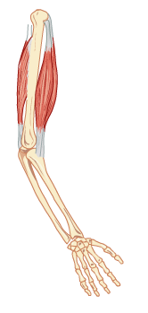
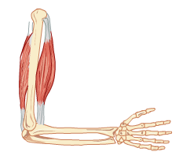
Understanding muscle action
Muscles are attached to bones by tendons.
The tendon at the non-moving (or fixed) end is known as the origin.
The tendon at the moving end is known as the insertion.
Muscles pull by contracting – they cannot push to produce the opposite movement.
Muscles are arranged in antagonistic pairs.
As one muscle contracts (shortens) its partner relaxes (lengthens). They swap actions to reverse the movement.

Slide 4
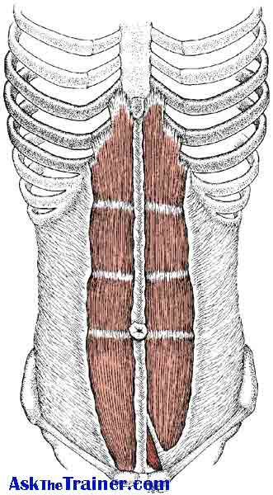
Rectus abdominus
Superficial muscle (located on or near surface of the body)
Muscles have tendinous lines giving “six pack” look
Origin: Crest of pubis
Insertion: Costal cartilage of ribs 5-7 & the xiphoid process of sternum
Joint(s) crossed:
Joint action:

Slide 5
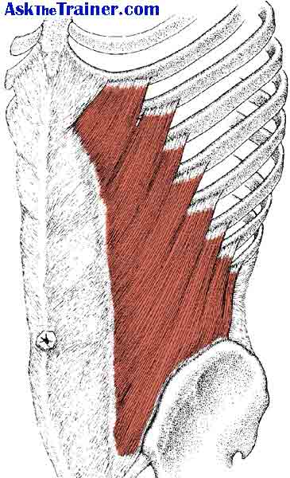
External obliques
Side and front of trunk, under the rectus abdominus
Origin: lower eight ribs
Insertion: Illium
Joint(s) crossed:
Joint action:

Slide 6
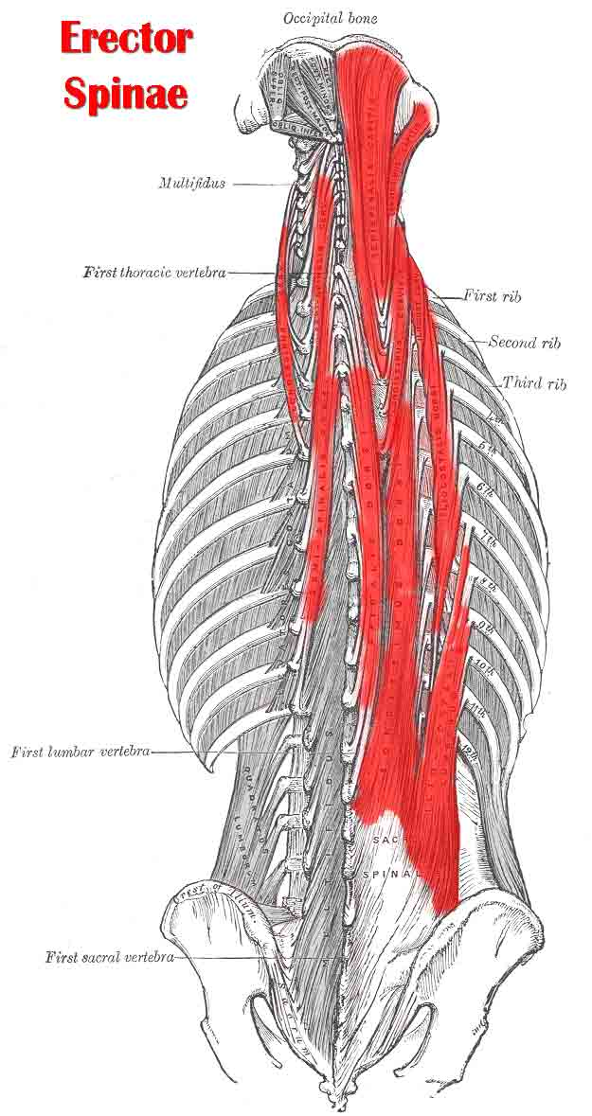
Erector Spinae
Overlapping muscles that run alongside most of the spine.
Origin: ribs, cervical, thoracic and lumbar vertebrae, ilium
Insertion: ribs, cervical, thoracic and lumbar vertebrae
Joint(s) crossed:
Joint action:

Slide 7
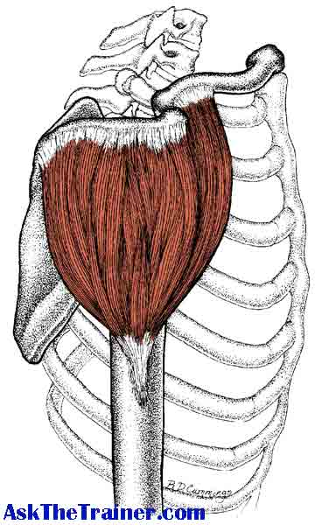
Deltoid
The deltoid has three heads.
Most prominent and useful shoulder muscles
Origin: scapula posteriorly and clavicle anteriorly
Insertion: lateral humerus
Joint(s) crossed:
Joint action:

Slide 8
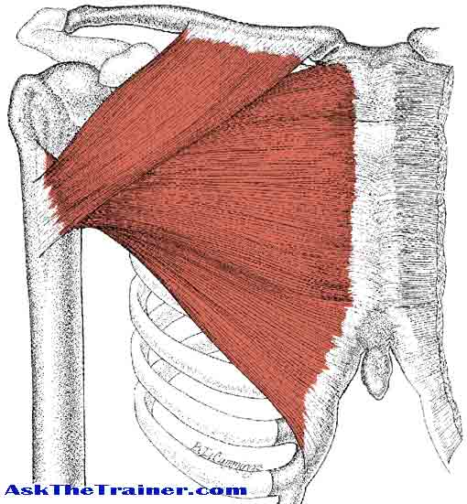
Pectoralis major
Tendon forms the front of the armpit.
Origin: clavicle, sternum and anterior ribs
Insertion: Inside of the humerus
Joint(s) crossed:
Joint action:

Slide 9
Biceps brachii
Two heads to this muscle (bi-ceps)
Origin: scapula
Insertion: Radius and ulna below the elbow joint
Joint(s) crossed:
Joint action:

Slide 10
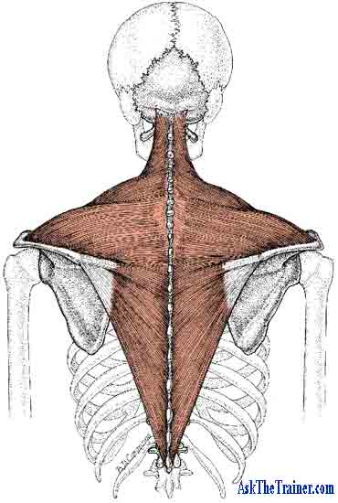
Trapezius muscle
Triangular shaped muscle located on the posterior neck and upper back
Origin: base of skull (along the cervical and thoracic vertebrae)
Insertion: clavicle and scapula
Joint(s) crossed:
Joint action:

Slide 11
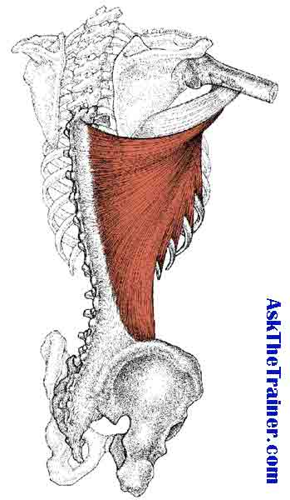
Latissimus dorsi
Large muscle on the back
Origin: runs from the sacrum and ilium up along the lumbar and thoracic vertebrae
Insertion: tendon forms posterior border of armpit and inserts on inside of the humerus (what muscle also inserts here?)
Joint(s) crossed:
Joint action:

Slide 12
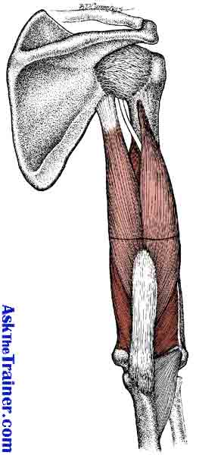
Triceps brachii
Posterior upper arm
Origin: scapula, humerus
Insertion: ulna
Joint(s) crossed:
Joint action:

Slide 13
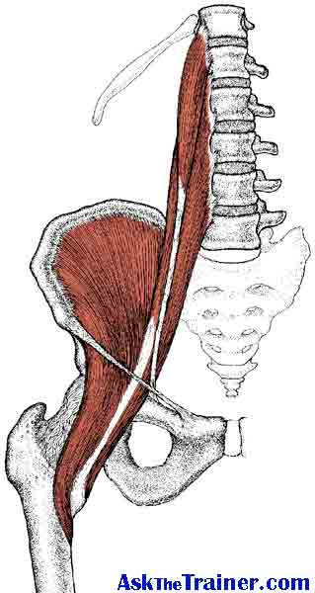
Iliopsoas
Origin: lumbar vertebrae
Insertion: inner femur
Joint(s) crossed:
Joint action:

Slide 14
Sartorius
Longest muscle of the body crossing the hip and knee joints
Origin: ilium
Insertion: medial tibia
Joint(s) crossed:
Joint action:

Slide 15
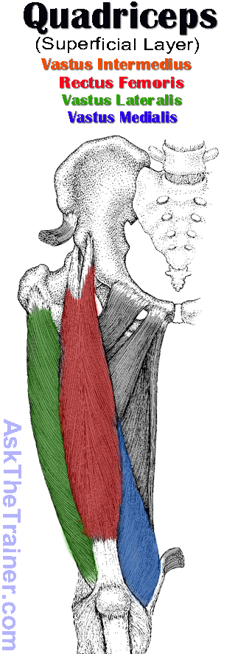
Muscle | Origin | Insertion | Joints Crossed | Joint Action
Rectus femoris | Ilium
Vastus lateralis | Femur
Vastus medialis | Femur
Vastus intermedius | Femur

Slide 16
Tibialis anterior
Front of the lower leg
Origin: lateral tibia
Insertion: First metatarsal and first cuneiform (one of the tarsal bones)
Joint(s) crossed:
Joint action:

Slide 17
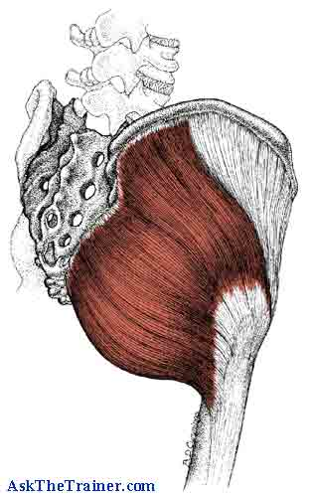
Gluteus maxiumus
Large muscle of the posterior hip and buttocks
Origin: Posterior ilium, sacrum, coccyx
Insertion: lateral femur
Joint(s) crossed:
Joint action:

Slide 18
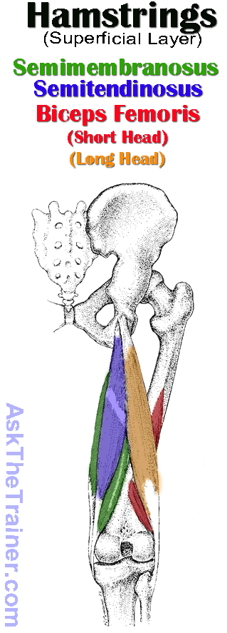
Muscle | Origin | Insertion | Joint Crossed | Joint Action
Biceps femoris | Ischium, femur | Fibula, lateral tibia
Semitendinosus | Ischium | Medial tibia
Semimembranosus | Ischium | Medial tibia

Slide 19
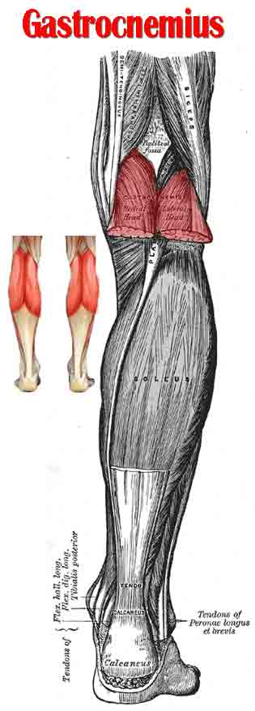
Gastrocnemius
Superficial muscle of the calf with two heads
Origin: Posterior femur
Insertion: Calcaneus (one of the tarsal bones) via the Achilles tendon
Joint(s) crossed:
Joint action:

Slide 20
Soleus
Located underneath the gastrocnemius of the calf
Origin: Posterior tibia and fibula
Insertion: Calcaneus-heel bone via the Achilles tendon
Joint(s) crossed:
Joint action:

